Slide 1



Portfolio Website

Slide 2

1
Quiz App
2
Snake Game
Projects
Notes App
3
4
To-Do List
5
XOX Game
6
Random Number Game

Slide 3



Portfolio

Slide 4

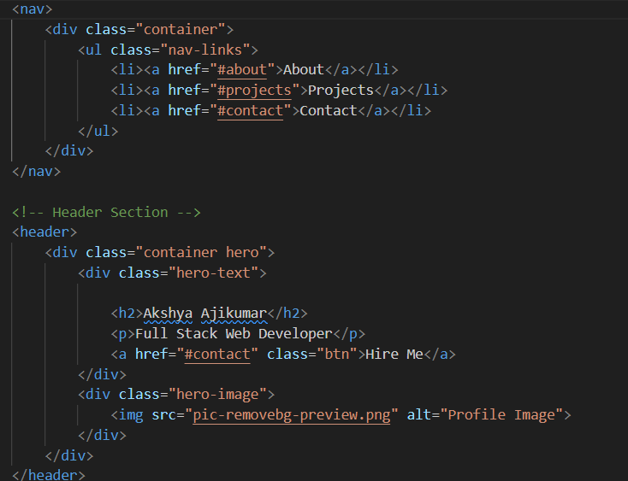
HTML
Navbar
Header Section

Slide 5

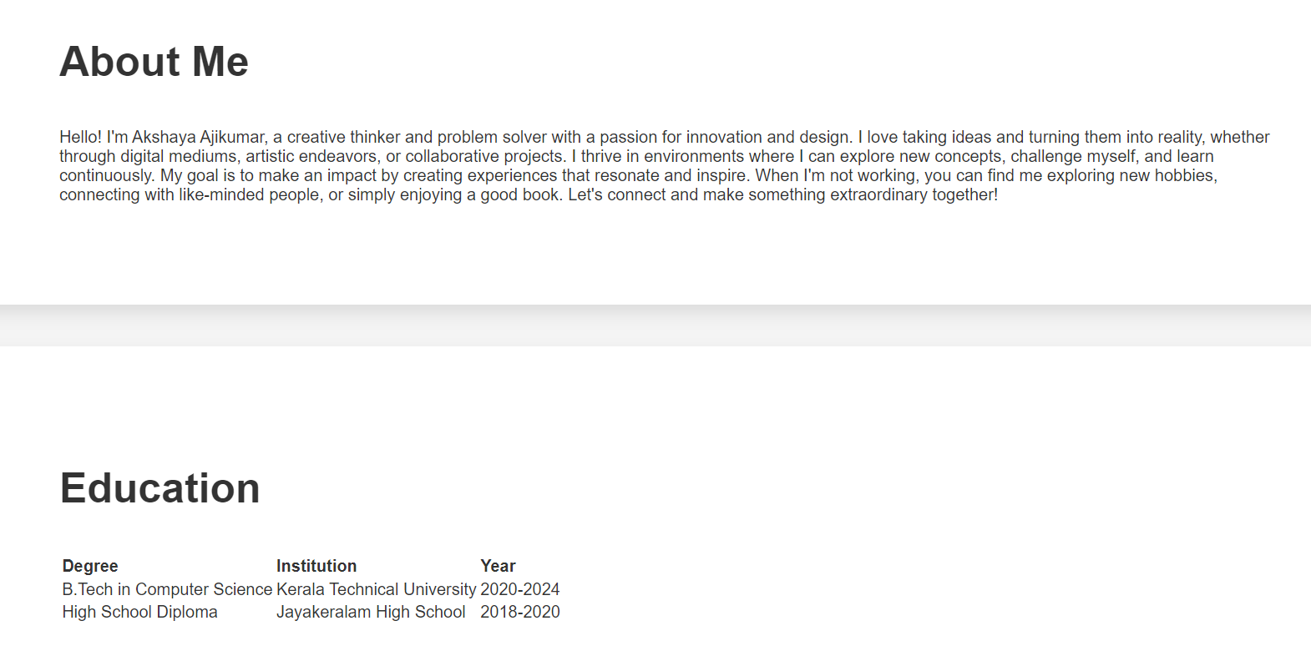

Slide 6
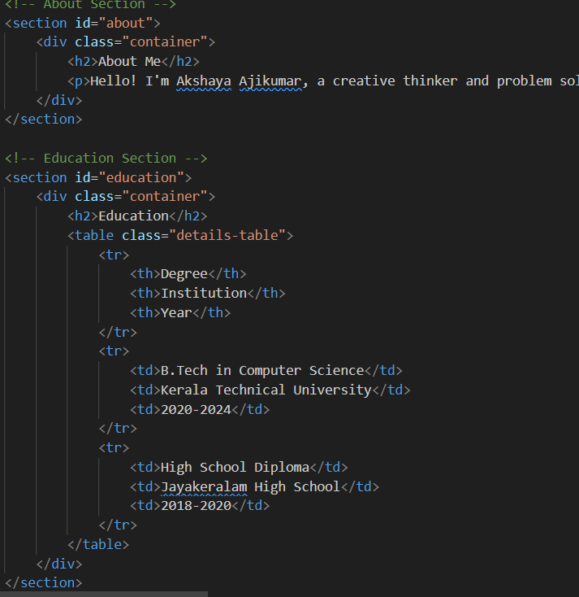
about section
un ordered list

Slide 7



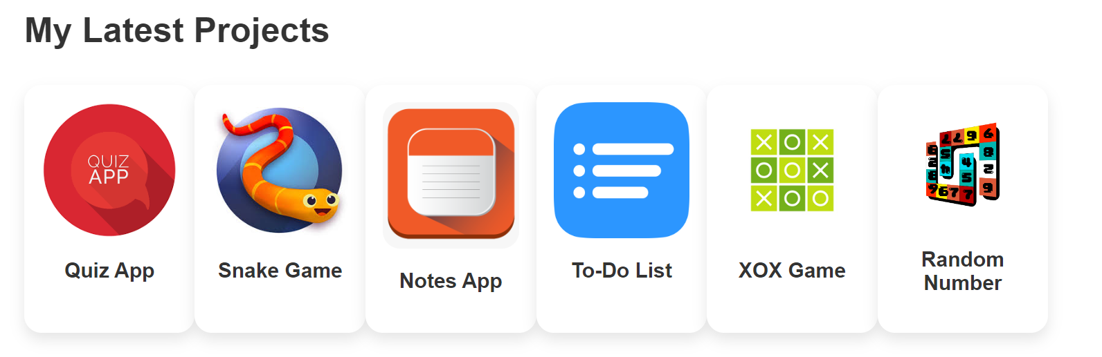

Slide 8
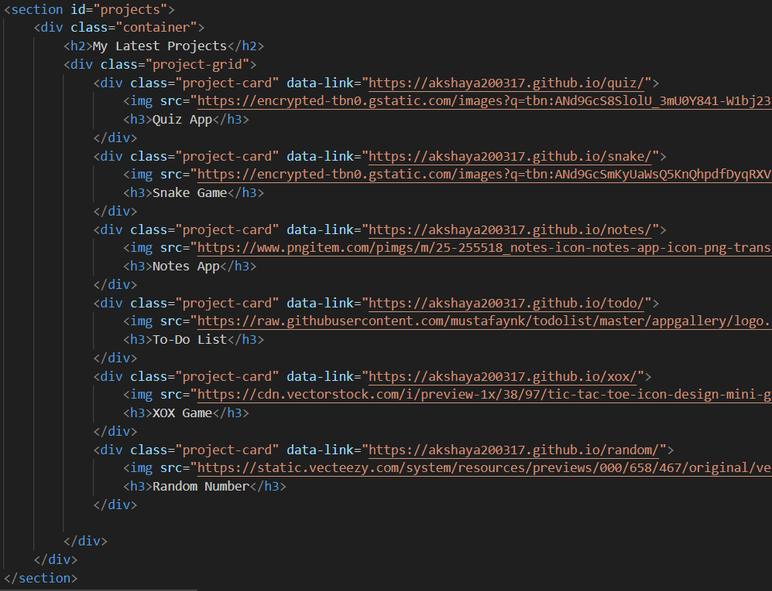
Project section
data-link
<img>

Slide 9

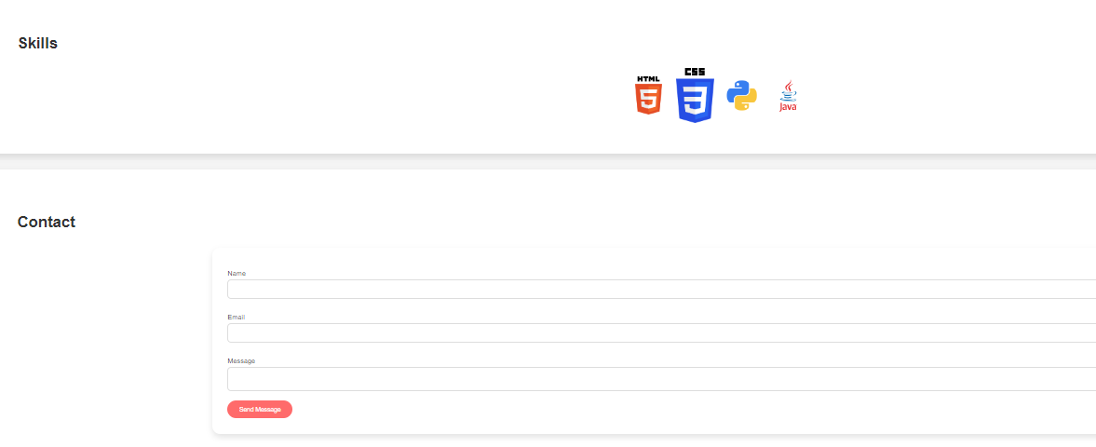

Slide 10
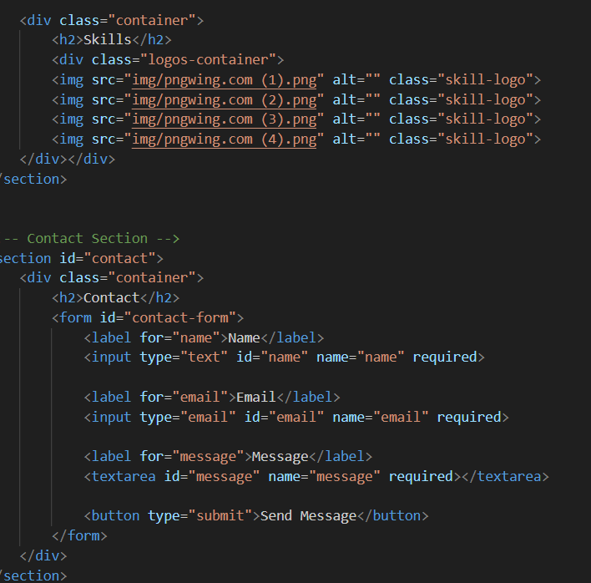
skills section
contact form

Slide 11
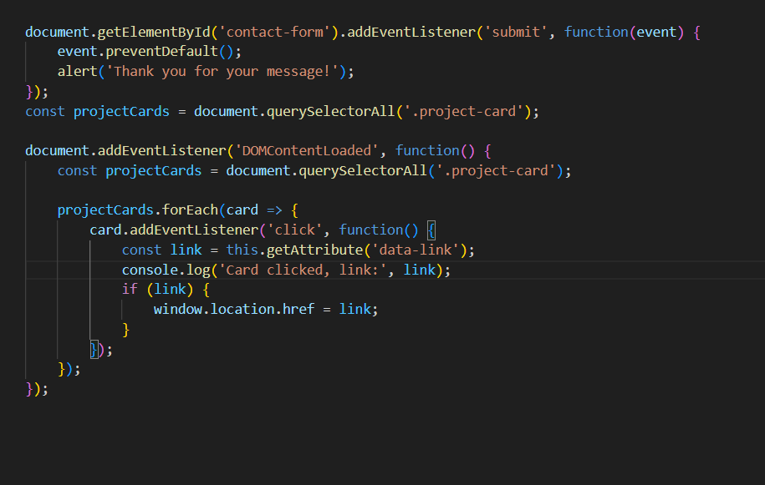
JavaScript
contact-form
alert()
productcard links
window.location.href = link

Slide 12
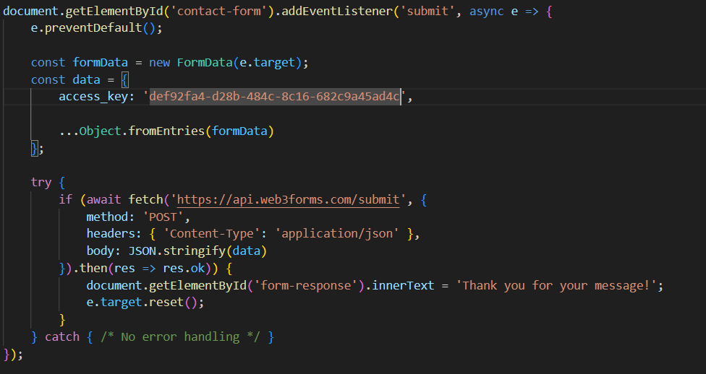
JavaScript
Web3forms
Api key
Thank you message
fetch

Slide 13

Thank you!

